Slide 1
Deliverable 3
Constraints, Standards, and Requirements Specifications

Slide 2
Constraints
Restrictions that allow the device to preform functions and fulfill requirements created by the client

Slide 3
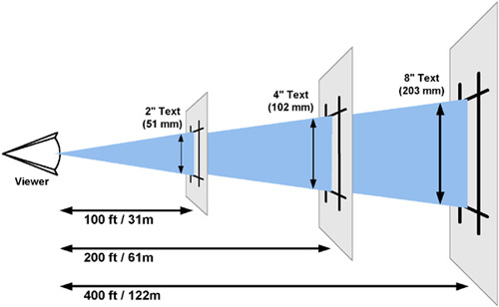
Functionality
Readability from 50m
Able to change the output of the display (with words, pics)

Slide 4
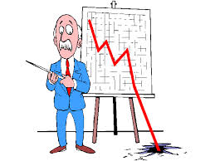
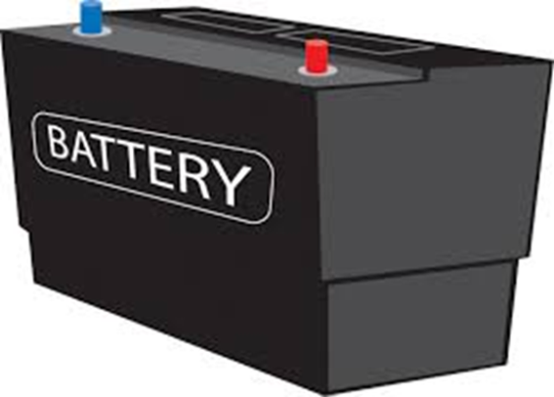
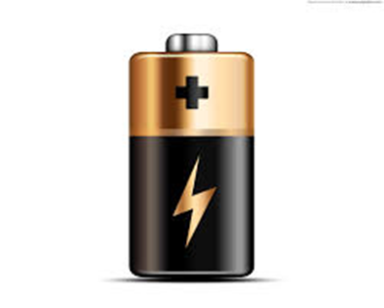
Economic Energy
<$250 start-up
not too expensive to mass produce
1 hour minimum run time
4 months sustained charge

Slide 5
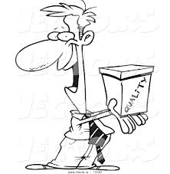

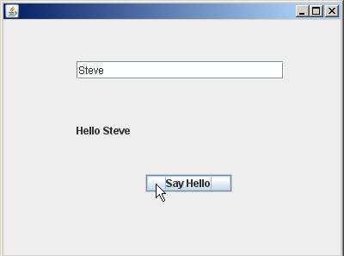
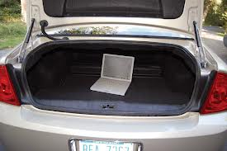
Usability
Easy to assemble
Fits in a car trunk
Easy to carry for
short distances
Simple software interface

Slide 6
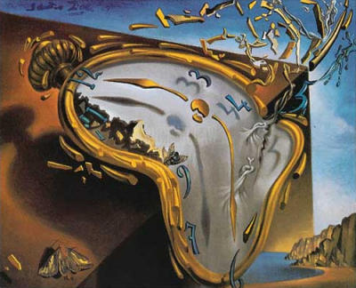
Health and Safety
avoid 960-1500 rpms in case of seizures, motor should stop quickly if
something obstructs rotation.
Time
Final presentation 4/16/14

Slide 7




Standards
ISO 13849-1- control systems
UL 94 Tests for flammability of plastic materials
Communications:
IEEE 803.11 Wireless radio
IEEE 802.15.1 (no longer maintained)
IEEE 802.14.4
Standard for low-rate wireless personal area networks
USB 3.0 Standard for USB connection

Slide 8
Deliverable 4
Morph Chart, Concept selection

Slide 9
Morph Chart
Features
 | option 1 | option 2 | option 3 | option 4
sensors | Infrared | Optic Encoder | potentiometer
LEDs | Regular rgb | SMD RGB LEDs | Triple Out High Power RGB LED | Piranha RGB LED
motor | DC |  | AC
motor | Brushed | Brushless | Synchronous | Induction(squirrel cage)
direction of spin | vertical axis | horizontal axis
microcontroller | arduino | PSoC | PiC
materials | wood | plastic | steel | aluminum
power systems | 9V battery | AA battery | AAA battery

Slide 10
Summary of Components
Sensors: for position of the wand
LEDs: the light emitter for the display
Motor, rotates the wand: rotating arm
Direction of spin: vertical or horizontal
Microcontroller: controls the motor, LEDs
Materials: for mechanical structure
Power systems: for LEDs, motor

